Slide 1
Predictive Modeling of Potential Substrates and
Inhibitors of BCRP in the Blood-Brain Barrier
Kendra Schorr, PharmD Candidate
Butler University
Mentor: Dr. Amanda Paulson, Ph.D.
2021 ATOM Internship Symposium | July 2021

Slide 2
Background

Slide 3
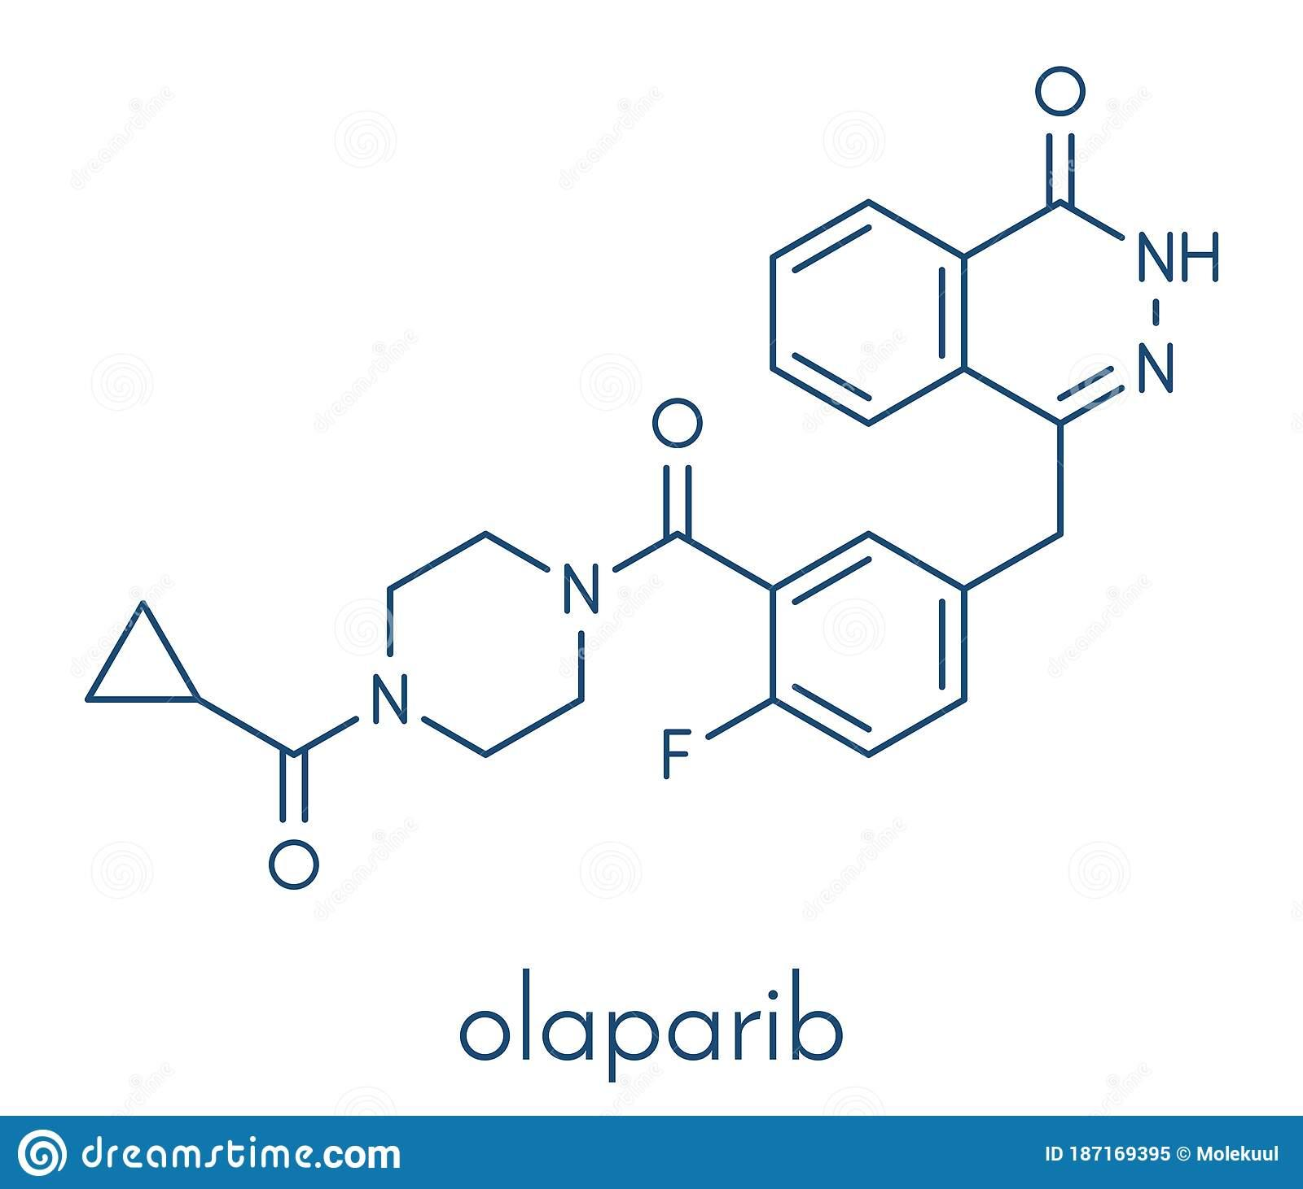
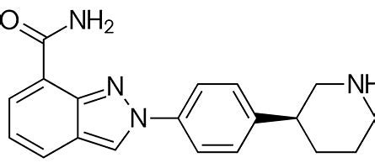
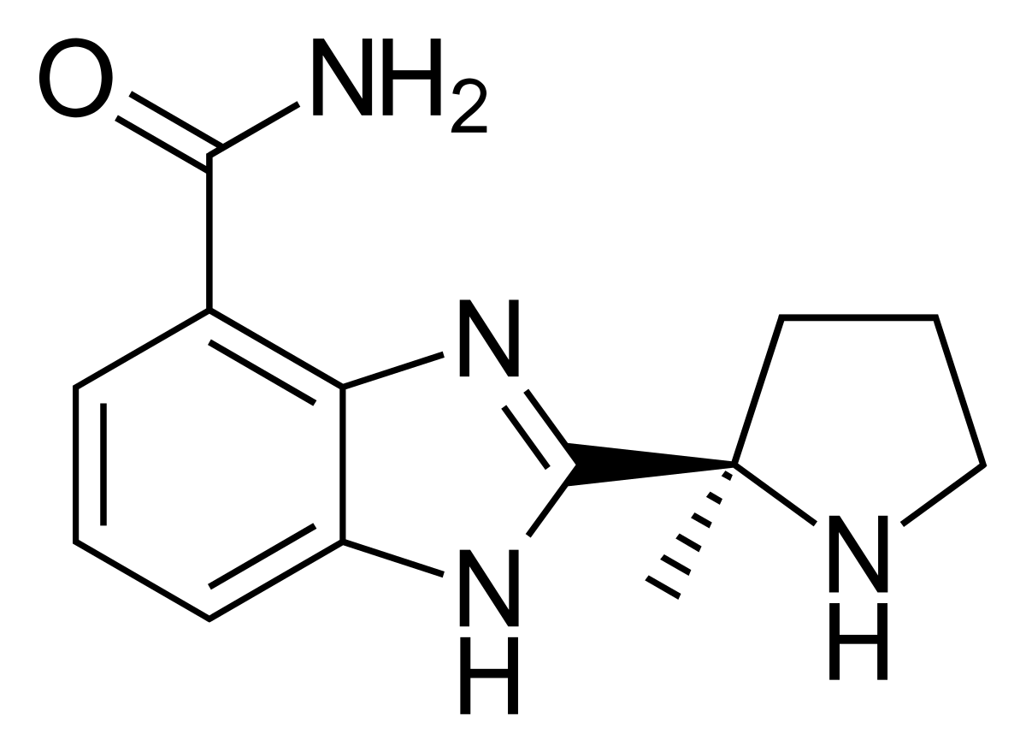
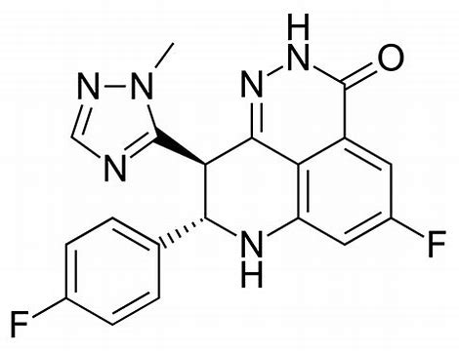
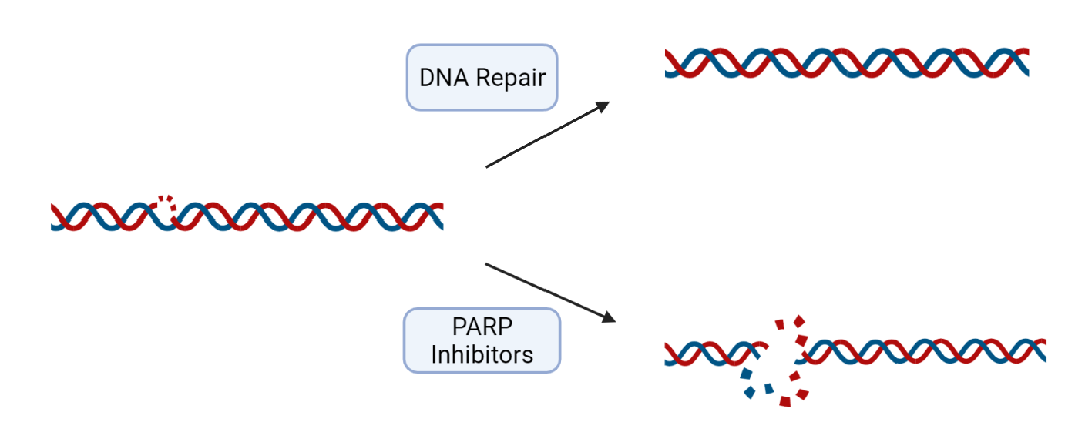
Poly(ADP-ribose) Polymerase Inhibitors (PARPi)
Niraparib
Veliparib
Talazoparib
Notes:
Prevent the recruitment of DNA repair proteins
Some PARPi can trap PARP onto DNA, which blocks replication fork progression and causes DNA damage

Slide 4
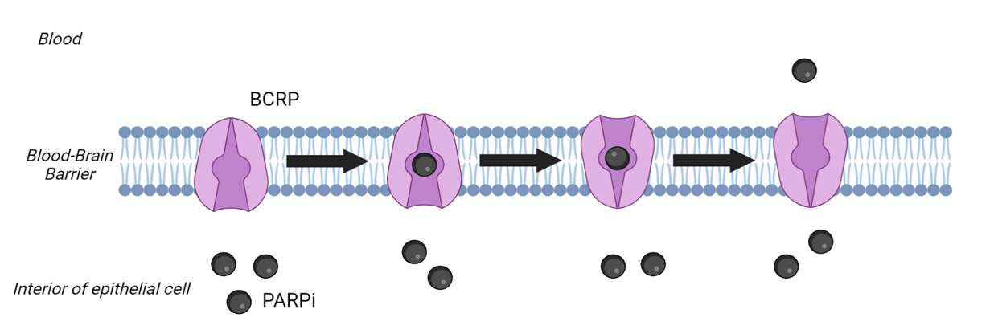
Breast Cancer Resistance Protein (BCRP)
ATP-binding cassette protein
Efflux membrane transporter
Located in blood-brain barrier, liver, placenta, kidney, and intestine
Drug resistance

Slide 5

Overall Process
Find data
-databases
-literature
Curate data
-Python
-Google Cloud
Build and train models
-splitting
-featurizing
-hyperparameter optimization
Analyze model metrics
Use best models for inference

Slide 6
Data

Slide 7
Data Sources
Source | Number of Values
Chembl | 4035
DTC | 1938
Excape | 26514
ADMET evaluation in drug discovery. 20. Prediction of breast cancer resistance protein inhibition through machine learning | 2800
Human intestinal transporter database: QSAR modeling and virtual profiling of drug uptake, efflux and interactions | 4789
Selective Fusion of Heterogeneous Classifiers for Predicting Substrates of Membrane Transporters | 4576
 | Regression | Classification
Inhibition | Chembl DTC ADMET | Human ADMET
Transport | Chembl DTC Excape | Human Selective Excape

Slide 8
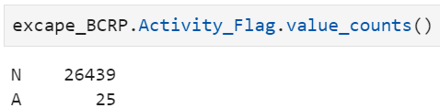
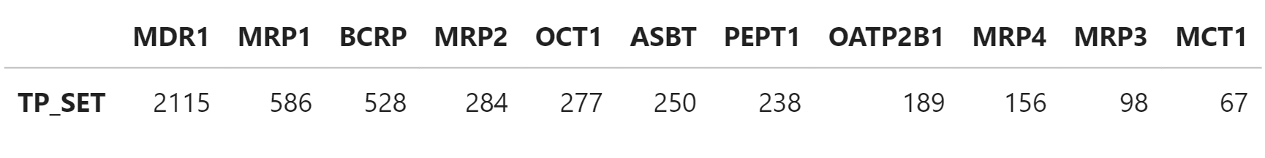
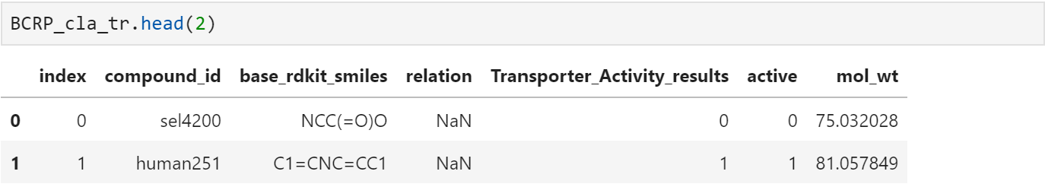
Curation and Concatenation
Subset data for IC50 and EC50 standard types (if regression)
Standardize data
Split data into inhibition and transport
Analyze assay description
Removed duplicates
Set a threshold for pXC50 values
Aggregated data
Concatenated data from all notebooks to make 4 final dataframes:
BCRP_reg_tr
BCRP_reg_in
BCRP_cla_tr
BCRP_cla_in

Slide 9
Final Numbers Before Training
Source | Number of Values
Chembl | 4035
DTC | 1938
Excape | 26514
ADMET | 2800
Human | 4789
Sel | 4576
Total | 44,652
Final Data Frame | Number of Values
BCRP_reg_tr | 157
BCRP_reg_in | 785
BCRP_cla_tr | 766
BCRP_cla_in | 814
Total | 2,522

Slide 10
Modeling

Slide 11
Scaffold Split
ECFP
RDKit
Mordred
MOE
Graph Conv
Random Forest
XGBoost
Neural Networks
Number of estimators: [16, 32, 64, 128, 256, 512]
Tree Depth: [16, 32, 64, 128, 256]
Max Features: [32, 64, 128, 256, 512]
Gamma: [0.0, 0.05, 0.1, 0.2, 0.3, 0.4, 0.5, 0.6, 0.7],
Learning Rates: [0.0001, 0.001, 0.01, 0.05, 0.1, 0.2, 0.25, 0.3, 0.4, 0.5]
Number of layers: [2, 3]
Layer Sizes:
[64, 128, 256, 512, 1024]
Learning Rates: [0.00001, 0.0005, 0.0001, 0.005, 0.001, 0.01, 0.05, 0.1, 0.15]
Dropouts: [0.1, 0.2, 0.3, 0.4, 0.5]

Slide 12
Post-Modeling
Inference

Slide 13
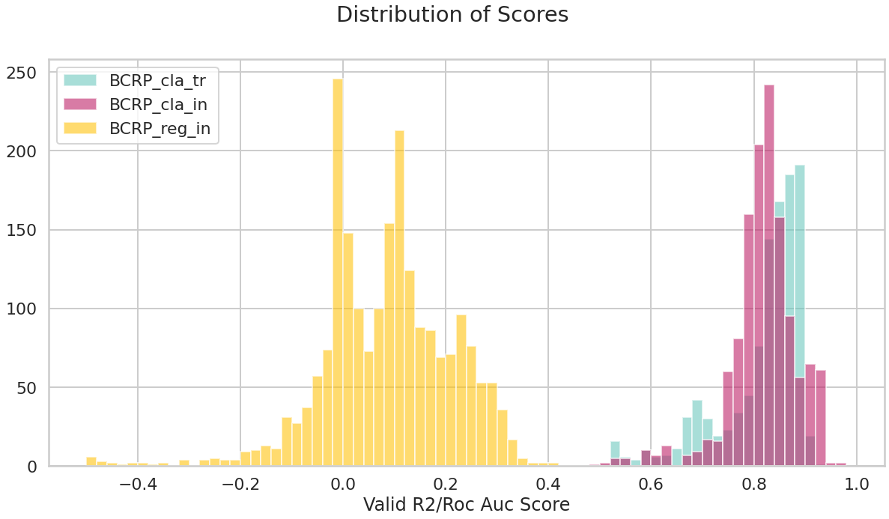
Distribution of Scores

Slide 14
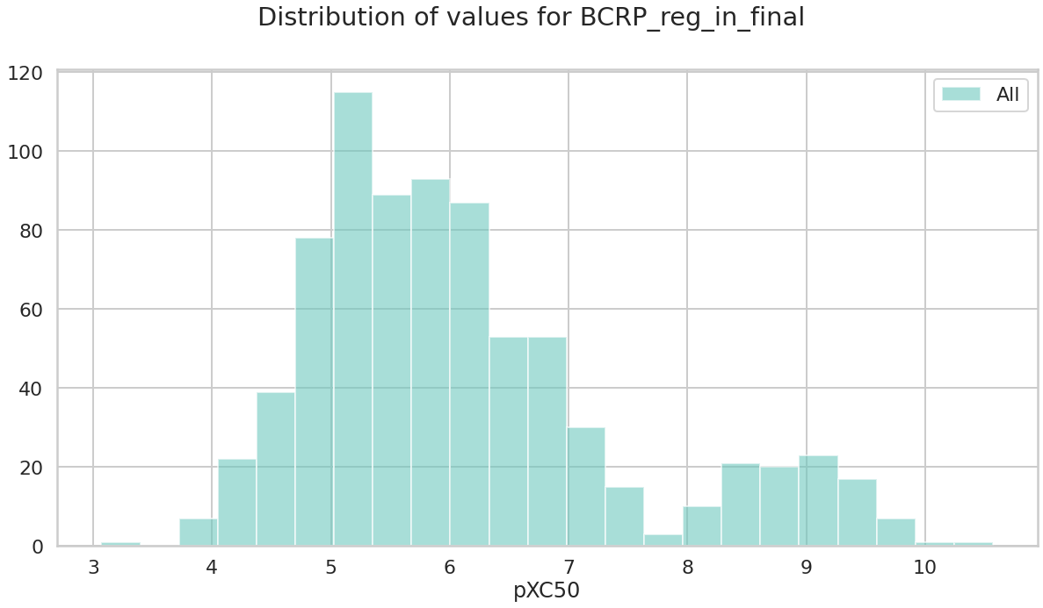
BCRP_reg_in Data

Slide 15
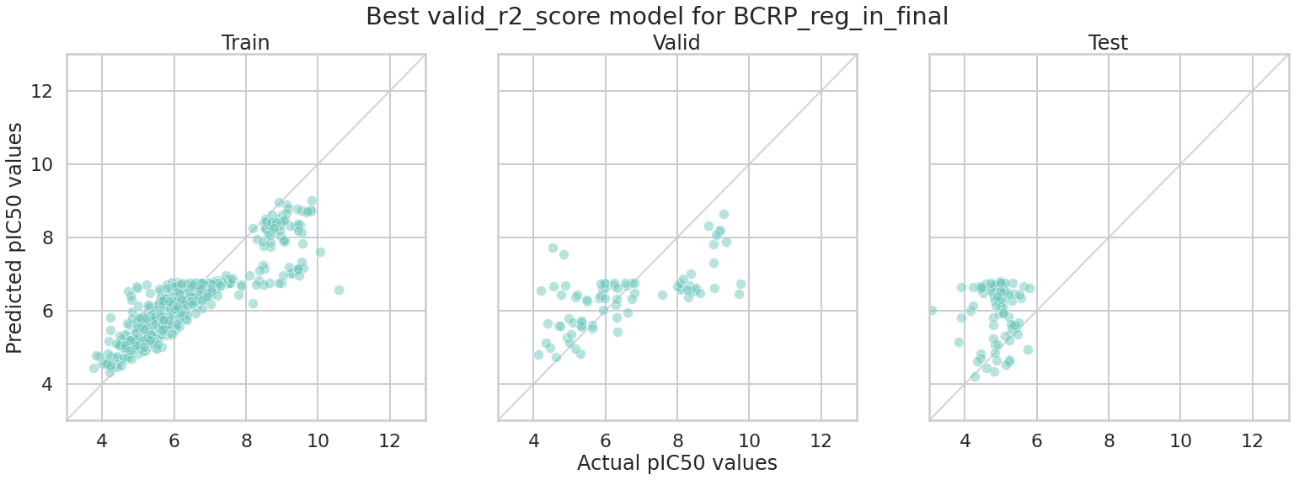
Regression

Slide 16
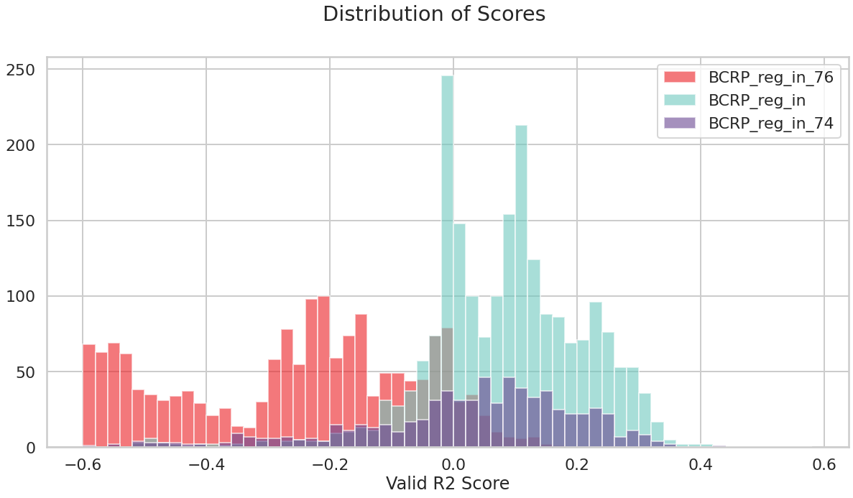
Did it work?
Data Set | Top Model R² Score
BCRP_reg_in | 0.4024
BCRP_reg_in_74 | 0.4261
BCRP_reg_in_76 | 0.1736

Slide 17
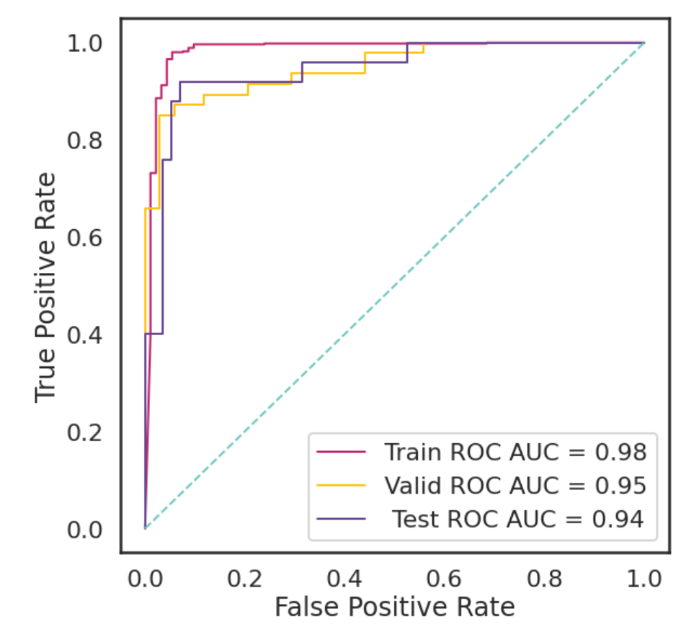
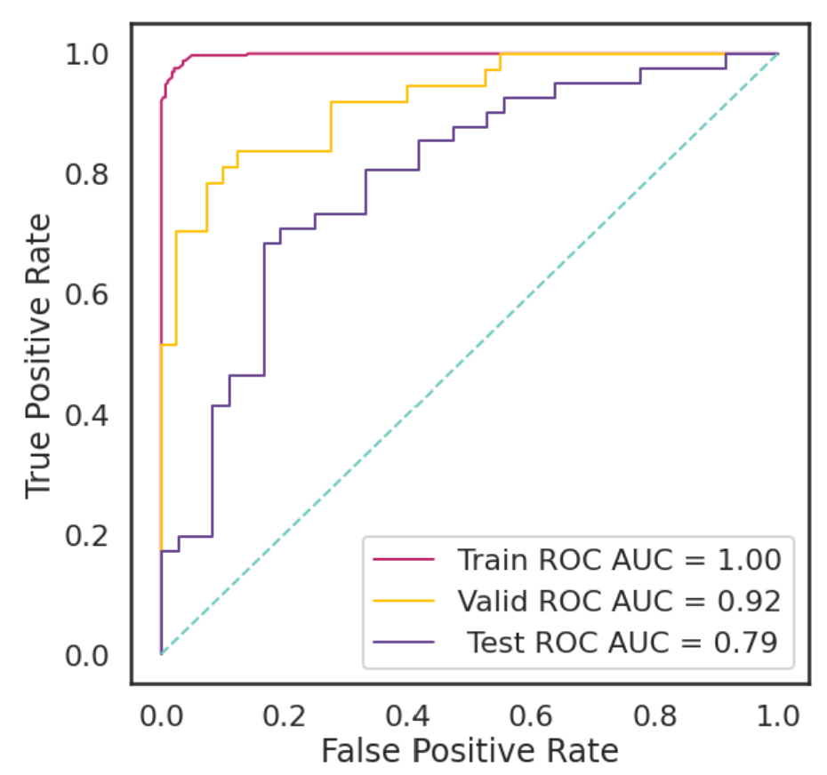
Classification
Best BCRP_cla_in Model
Best BCRP_cla_tr Model

Slide 18
Conclusions and Future Directions

Slide 19
Best Models
 | Classification |  | Regression
 | Inhibition | Transport | Inhibition
Featurizer | RDKit | Mordred | Mordred
Model | Neural Networks | Neural Networks | Neural Networks
Roc Auc Score/R² score | 0.9634 | 0.9209 | 0.4024

Slide 20
Future Directions
Dive deeper into regression data
Classify first, then build regression models
Analyze individual molecules
Is our model good enough?
Find more data to work with

Slide 21
Acknowledgements

Slide 22
THANK YOU!
Amanda Paulson, Ph.D.
Caleb Class, Ph.D.
Susan Mertins, Ph.D.
Da Shi, Ph.D.
Sarangan Ravichandran, Ph.D.
Interns: Sarah, Ryan, Caiden, Zahra, Natalia

Slide 23
References
Bioactivities for ABCG2. Drug Target Commons. Accessed June 9, 2021. https://drugtargetcommons.fimm.fi/bioactivities?id=DTCT0027880&category=Target&name=ABCG2
Excape Chemogenomics Database. Excape. Accessed June 9, 2021. https://solr.ideaconsult.net/search/excape/
Jiang D, Lei T, Wang Z, Shen C, Cao D, Hou T. ADMET evaluation in drug discovery. 20. Prediction of breast cancer resistance protein inhibition through machine learning. J Cheminform. 2020;12(1):16. Published 2020 Mar 5. doi:10.1186/s13321-020-00421-y
Sedykh A, Fourches D, Duan J, et al. Human intestinal transporter database: QSAR modeling and virtual profiling of drug uptake, efflux and interactions. Pharm Res. 2013;30(4):996-1007. doi:10.1007/s11095-012-0935-x
Shaikh N, Sharma M, Garg P. Selective Fusion of Heterogeneous Classifiers for Predicting Substrates of Membrane Transporters. J Chem Inf Model. 2017;57(3):594-607. doi:10.1021/acs.jcim.6b00508
Target Report Card. ChEMBL. 2018. Accessed June 9, 2021. https://www.ebi.ac.uk/chembl/target_report_card/CHEMBL5393/
What to Know about PARP Inhibitors. Medical News Today. Accessed July 6, 2021. https://www.medicalnewstoday.com/articles/parp-inhibitor

